Slide 1

Data Analytics Virtual Internship by ANZ
Task 1 - Explortory Data Analytics

Slide 2
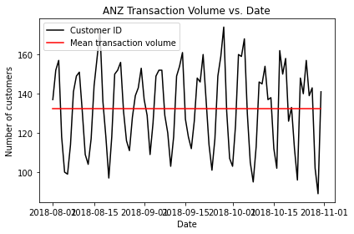
Volume Vs Data

Slide 3
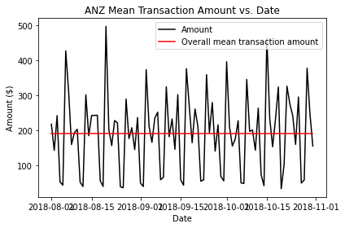
Transaction Amount Vs Date

Slide 4
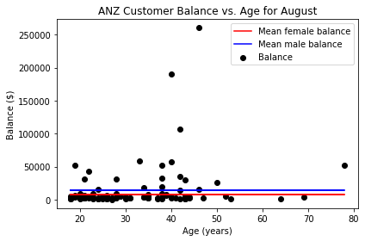
Balance Vs Age for August

Slide 5
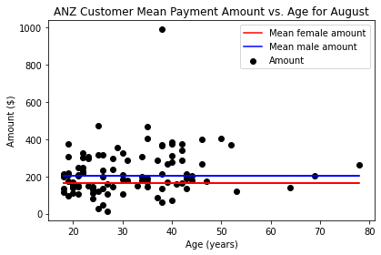
Amount Vs Age for August

Slide 6
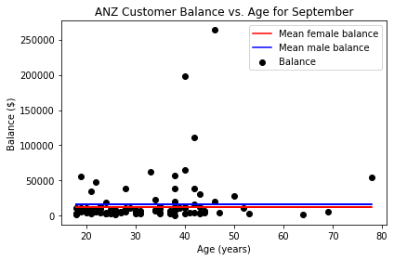
Balance Vs Age for September

Slide 7
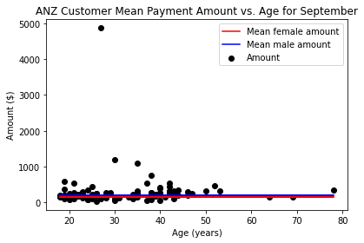
Amount Vs Age for September

Slide 8
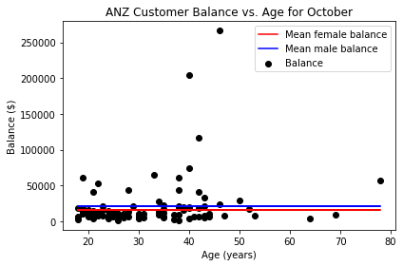
Balance Vs Age for October

Slide 9
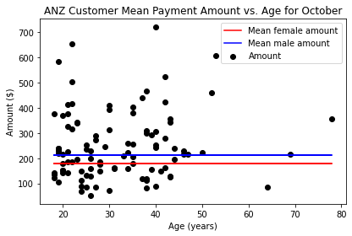
Mean Payment Vs Age for October

Slide 10
Decision Tree Regression Score Linear Regression Tree Score
68.30 %
31.69%

